Slide 1
Chapter Seven
Text file, String, csv file

Slide 2
Reading and Writing Text Files

Slide 3
Text Files
Text files are very commonly used to store information.
They are the most ‘portable’ types of data files.
Examples of text files include files that are created with a simple text editor, such as Windows Notepad, and Python source code and HTML files.

Slide 4
Opening Files: Reading
To access a file, we must first open it.
It is easiest to store the file in the same directory as the program.
To open a file for reading, we provide the name of the file as the first argument to the open function and an optional string "r" as the second argument:
We can also omit the “r” mode, the default is open for reading
When opening a file for reading, the file must exist and be accessible or an exception will occurs.
The object returned by the open function is a file handle, which must be saved in a variable, because all operations for accessing a file are made via the file handle.
infile = open("input.txt", "r")
infile = open("input.txt")

Slide 5
Opening Files: Writing and Appending
To open a file for writing, we provide the name of the file and the required string "w" to the open function:
outfile = open("output.txt", "w")
If the output file already exists, then the new data overwrites all existing data.
If the file does not exist, an empty file is created.
To open a file for appending, we provide the name of the file and the required string “a" to the open function :
outfile = open("output.txt", "a")
If the output file already exists, then the new data will be written starting at the end of the existing data, or append to the existing data.
If the file does not exist, an empty file is created.

Slide 6
Closing Files: Important
When we are done processing a file, we need to close the file:
infile.close()
outfile.close()
If our program exits without closing a file that was opened for writing, some of the output may not be written to the file.
It is good practice to free up all resources, such as input / output files, that our code acquires when it runs. For files, this is done with the close of the file handle.

Slide 7
Open File Using the With Statement
The with statement provides a shorter and more convenient way to open a file.
The with statement will close the file for us so we don’t have to remember to do it.
Examples
with open (“inputFile.txt”) as infile:
# indented block of code to read data from infile
# no close() needed
with open (“outputfile.txt, “w”) as outfile:
# indented block of code to write data to outfile
# no close() needed
The file is automatically closed by the with statement when execution goes outside of the indented block of code.

Slide 8
Reading From a Text File
To read a line of text from a file, call the readline method of the file handle object:
line = infile.readline()
When a file is opened for reading, an input marker is positioned at the beginning of the file.
The readline method reads a line of text, starting at the current marker position and continuing until the end of the line is encountered.
The input marker is then moved to the next line.
This is called a sequential read, the lines are read one after another in sequence.

Slide 9
Example of Reading From a File
Suppose input.txt contains the 2 lines:
flying
circus
The first call to readline returns the string "flying\n"
Recall that \n denotes the newline character that indicates the end of the line
If we call readline() a second time, it returns the string "circus\n"
Calling readline() again yields the empty string "" because we have reached the end of the file and there’s no more line to read.
If the file contains a blank line, then readline returns a string containing only the newline character "\n"

Slide 10
Reading Lines From a File
We can use a while loop to repeatedly read a line of text and process it until the sentinel value is reached.
The sentinel value is typically an empty line, but it could be any character.
line = infile.readline() # read first line
while line != "" :
# Process the line
line = infile.readline() # read next lines
We can also use a for loop to repeatedly read a line of text and process it until the end of file has been reached.
In this case, the file handle acts as a container of input lines.
for line in infile :
# Process the line

Slide 11
Converting Input Text from a File
As with the input function, the readline() method can only return strings.
If the file contains numerical data, the strings must be converted to the numerical value using the int() or float() function:
value = float(line)
The newline character at the end of the line is ignored when the string is converted to a numerical value.

Slide 12
Writing To A File
We can write the string "Hello, World!" to our output file using the write method:
outfile.write("Hello, World!\n")
Unlike print(), the write function accepts only one string as input.
Unlike print(), when writing text to an output file, we must explicitly write the newline character to start a new line.
We can also write formatted strings to a file:
outfile.write("Count: {:d}\nTotal: {:.2f}\n".format(cnt,tot))

Slide 13
Text Input and Output

Slide 14


Removing The Newline
Suppose we have a file that contains 3 lines:
Recall that each input line ends with a newline (\n) character.
Use the rstrip (for right strip) method to remove the newline character, which is at the right end of the line:
Resulting in the line:
spam
and
eggs
line = line.rstrip()

Slide 15
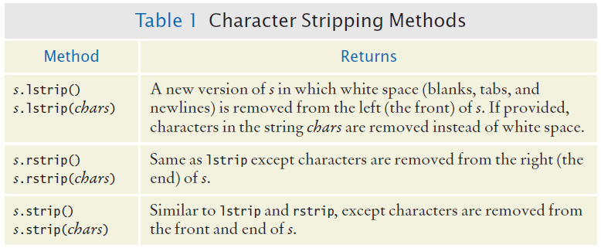
Character Strip Methods

Slide 16
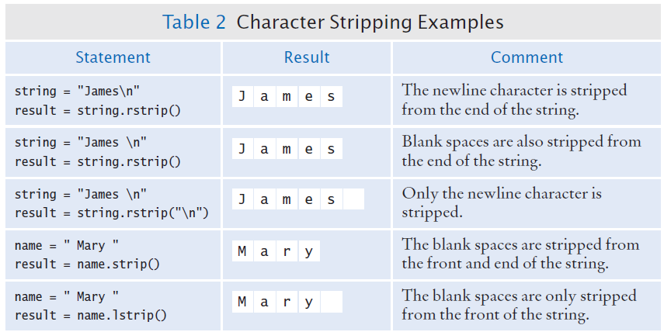
Character Strip Examples

Slide 17
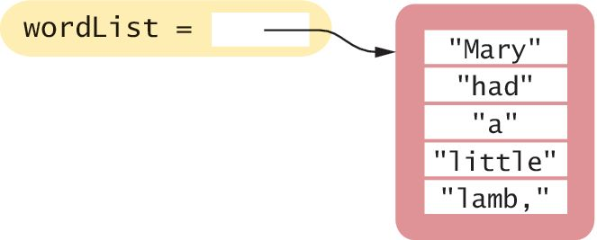
Reading Words
Sometimes we need to process the individual words from a text file.
For example, suppose our input file contains two lines of text:
Mary had a little lamb,
whose fleece was white as snow.
We would like to print to the terminal, one word per line.
Because there is no method for reading a word from a file, we first read the entire line and then split it into individual words:
The split method splits the line by white space and returns each word in a list.
line = infile.readline()
wordlist = line.split()

Slide 18
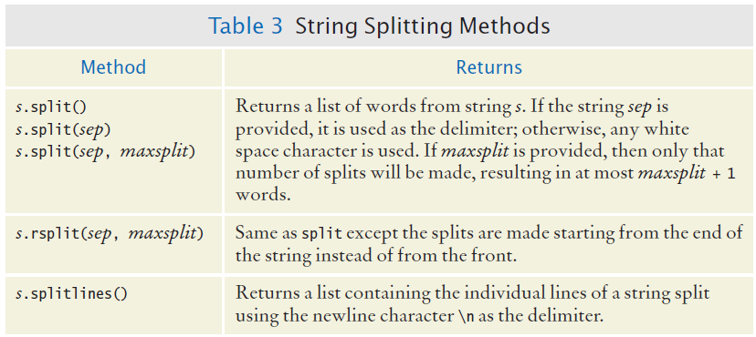
Additional String Split Methods

Slide 19
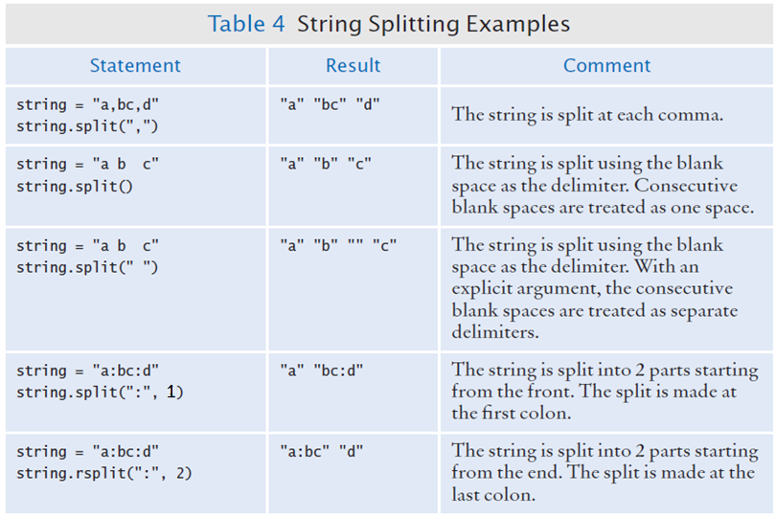
String Split Examples

Slide 20
String Join Method
The join method takes a list as input argument and joins each element of the list into a string, using the current string as the “glue” between each element
The method returns the resulting string.
names = ["Python", "C++", "Java"]
" ".join(names) # yields: "Python C++ Java"
" - ".join(names) # yields: "Python - C++ - Java"
"".join(names) # yields: "PythonC++Java"

Slide 21
Reading Characters
The read method takes a single argument that specifies the number of characters to read
The method returns a string containing the characters
When supplied with an argument of 1, the read method returns a string consisting of the next character in the file
char = inputFile.read(1)
If the end of the file is reached, it returns an empty string "“
To read in one character at a time until the end of file:
char = inputFile.read(1)
while char != "" :
# Process character
char = inputFile.read(1)

Slide 22
Letters of the Alphabet
Sometime it is useful to have a list of all uppercase and / or lowercase letters.
The string module has strings of all letters so we don’t have to type all of them
import string
lower = string.ascii_lowercase
# lower is the string ‘abcdefghijklmnopqrstuvwxyz’
upper = string.ascii_uppercase
# upper is the string ‘ABCDEFGHIJKLMNOPQRSTUVWXYZ’
letters = string.ascii_letters
# letters is the string contain all upper and lower
# case letters

Slide 23
Reading and Writing CSV Files

Slide 24
CSV Files
In addition to reading and writing plain text files, Python can read / write many other file formats.
One common format that is used with large numbers of data values is the CSV format or comma separated value format.
An example line of a CSV file:
Monty Python And The Holy Grail,1975,Terry Gilliam and Terry Jones
There are 3 fields: movie title, year released, directors. The 3 fields are separated by a comma.
The CSV format is like a spreadsheet: each line is one data record or one row of a spreadsheet. The fields in a line are the columns of the spreadsheet.
CSV files can also be opened and read as a text file.

Slide 25
Opening CSV Files
Opening a CSV file is the same as opening a text file: use the with statement and the open function.
For reading:
For writing:
with open("inputfile.csv") as infile :
with open("outputfile.csv","w",newline="") as outfile :

Slide 26
Reading CSV Files
To read from a CSV file we first need to import the csv module, which gives us a csv.reader object and a csv.writer object.
The csv.reader object reads the CSV file and returns each line of the file as a list of the comma separated fields.
Example:
import csv
with open("inputfile.csv") as infile :
reader = csv.reader(infile) # reader is our name
# for the csv.reader object
for line in reader : # each line is a list of
# comma separated fields
print(line[0], line[-1]) # print first and last fields

Slide 27
Writing CSV Files
To write to a CSV file we use the csv.writer object of the csv module.
The csv.writer object has a writerow method that writes to file a list of data as a line of comma separated values .
Example:
import csv
with open("outputfile.csv", "w", newline="") as outfile :
writer = csv.writer(outfile) # writer is our name
# for the csv.writer object
writer.writerow(aList) # write the list to file as a line # of comma separated values

Slide 28
End of File IO Notes

